Slide 1
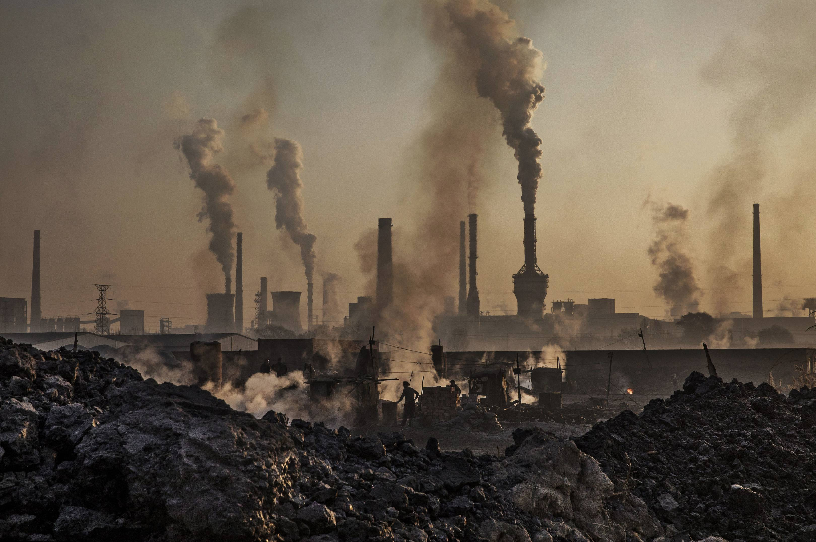
Environment Pollution

Slide 2
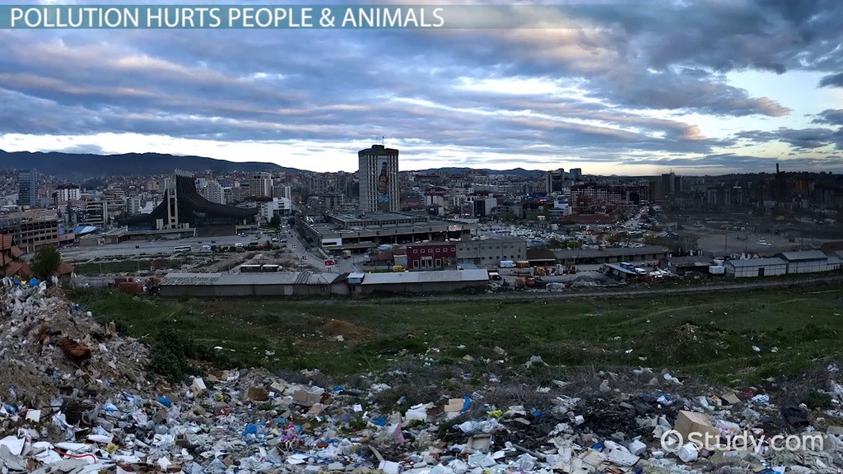
What is Pollution?
What is Pollution
Pollution is anything that makes the earth dirty and unhealthy.
Land, air, and water are all affected by pollution.
Pollution takes up space on our land.

Slide 3
Types of Environment Pollution
Air Pollution
Water Pollution

Slide 4
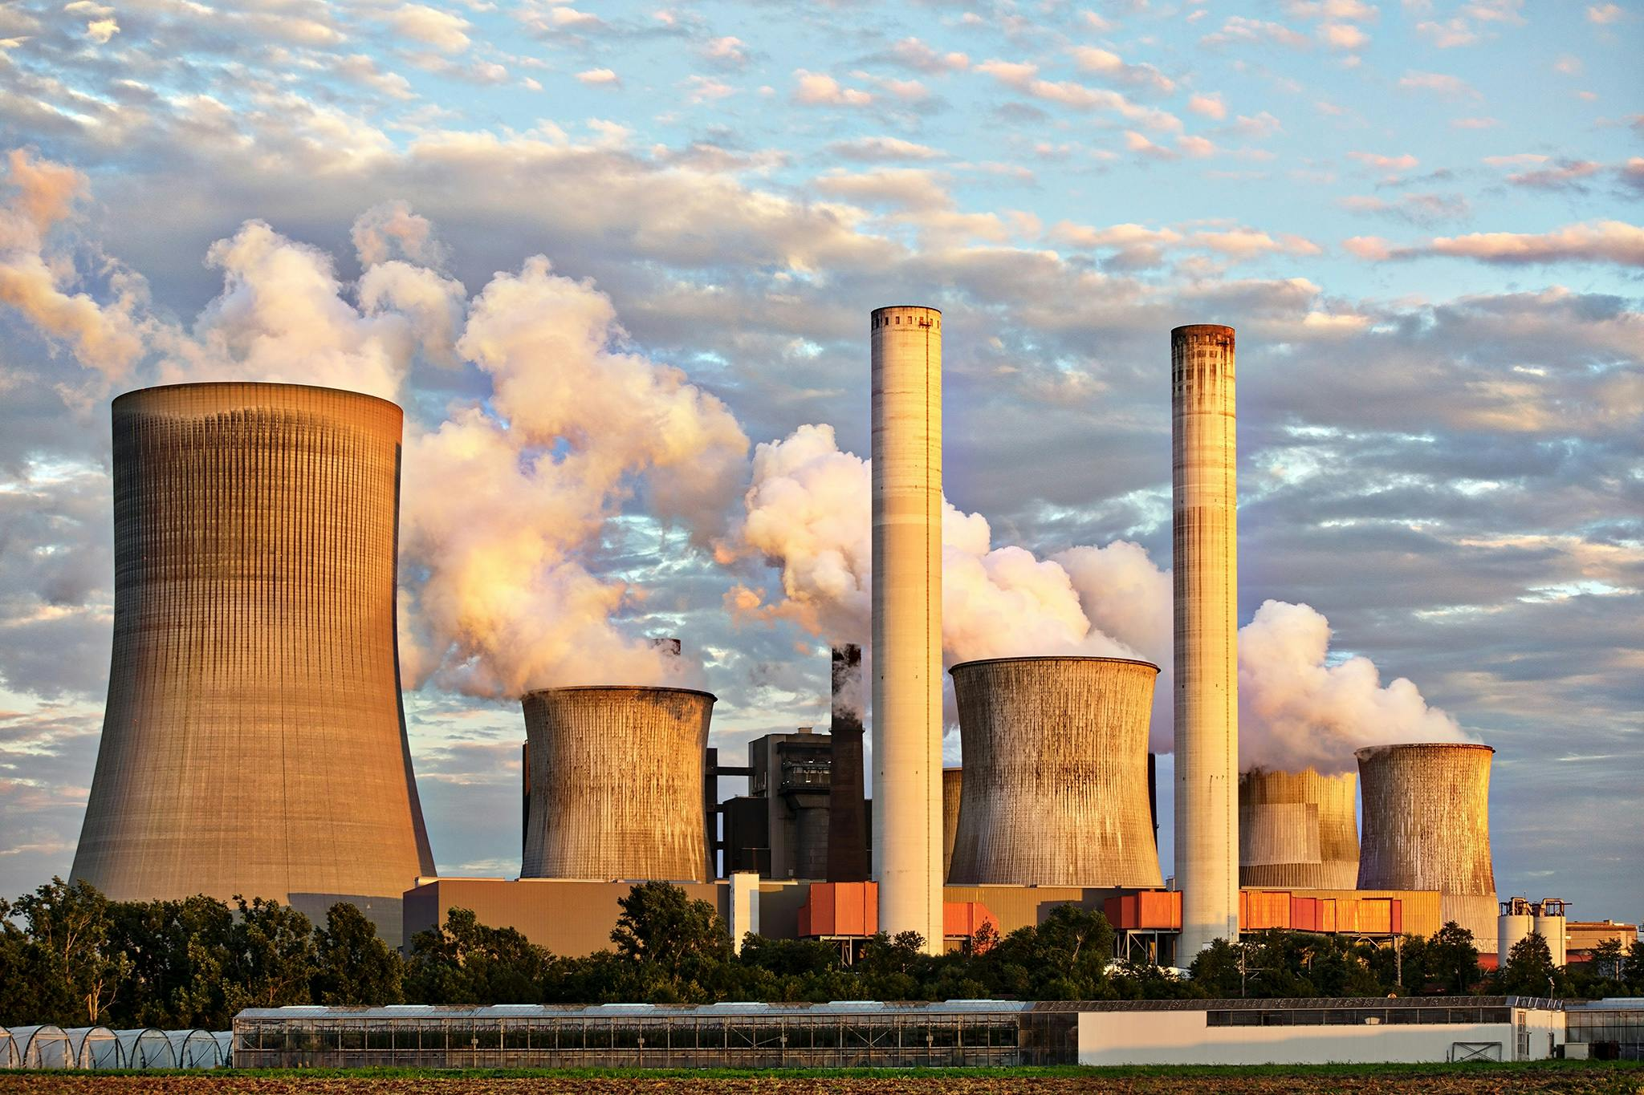
What is Air Pollution?
Contamination of Air by harmful substances like poisonous, gases , smoke, particular matter, microbes
Etc.is called as Air pollution.

Slide 5
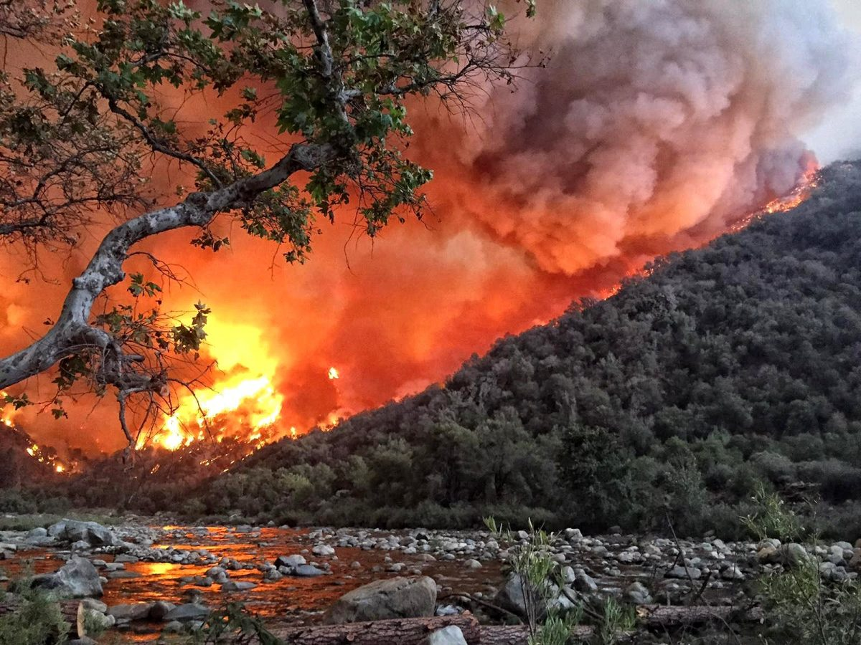
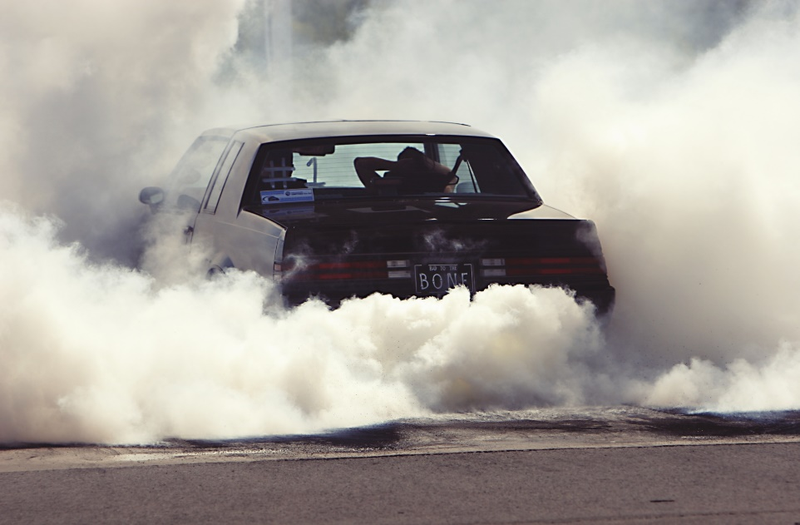
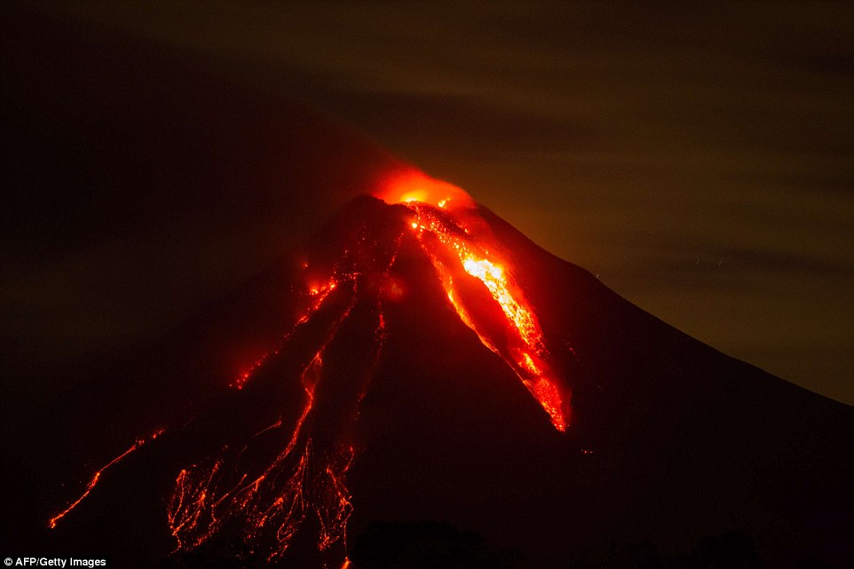
Cause of Air Pollution
Forest fire
Smoke fire vehicles
Volcanic eruption

Slide 6
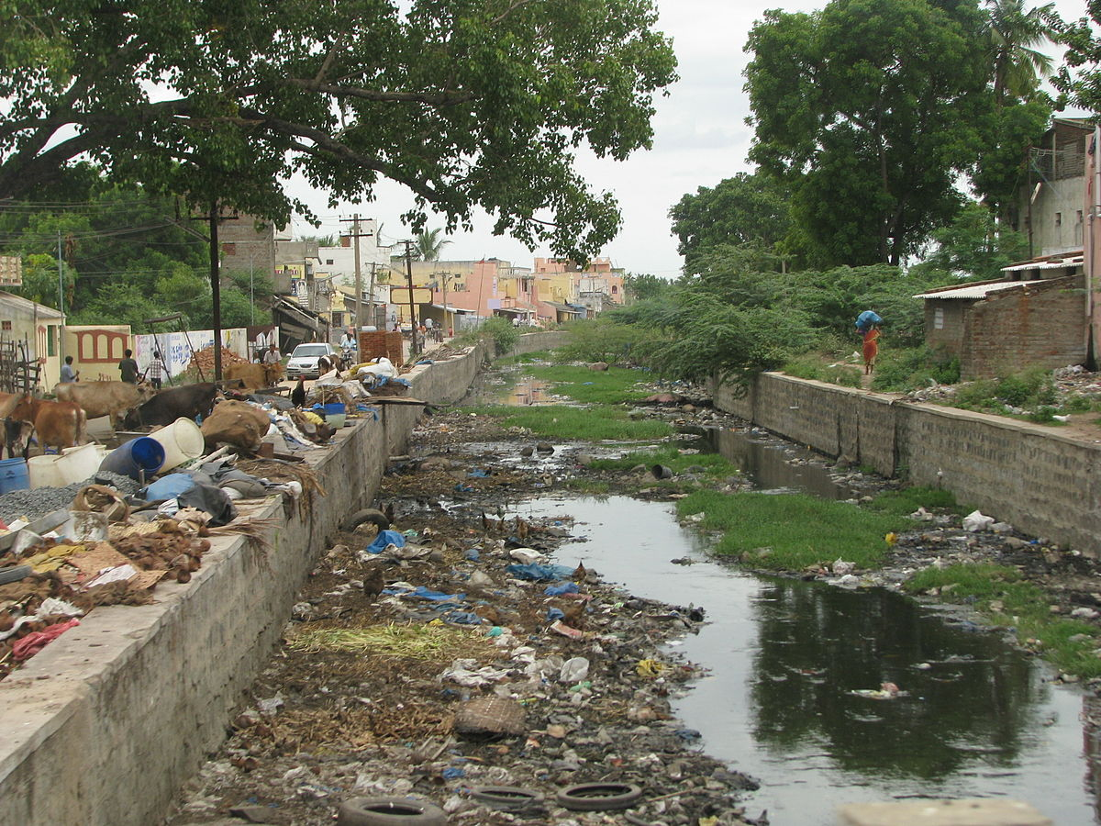
What is Water Pollution?
Water pollution is the release of substances into bodies of water that makes water unsafe for human use and disrupts aquatic ecosystems.

Slide 7
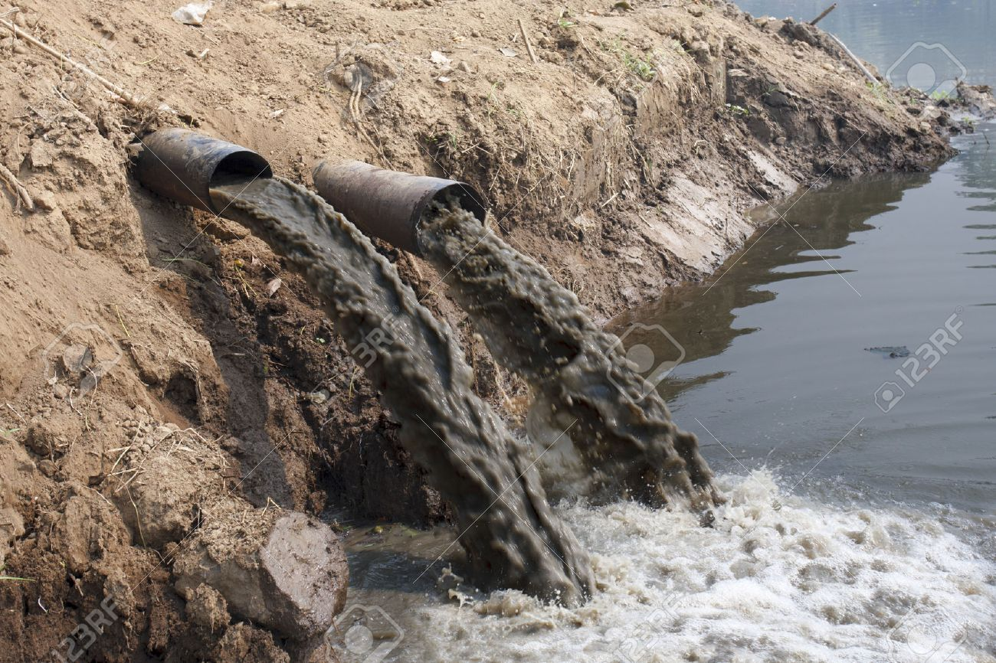
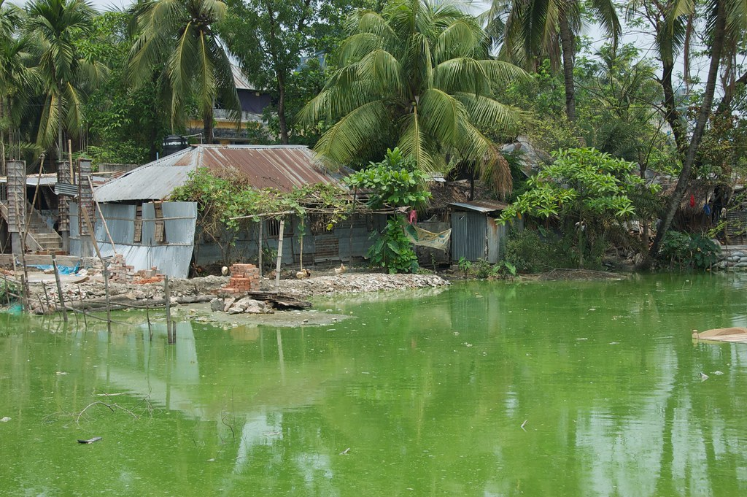
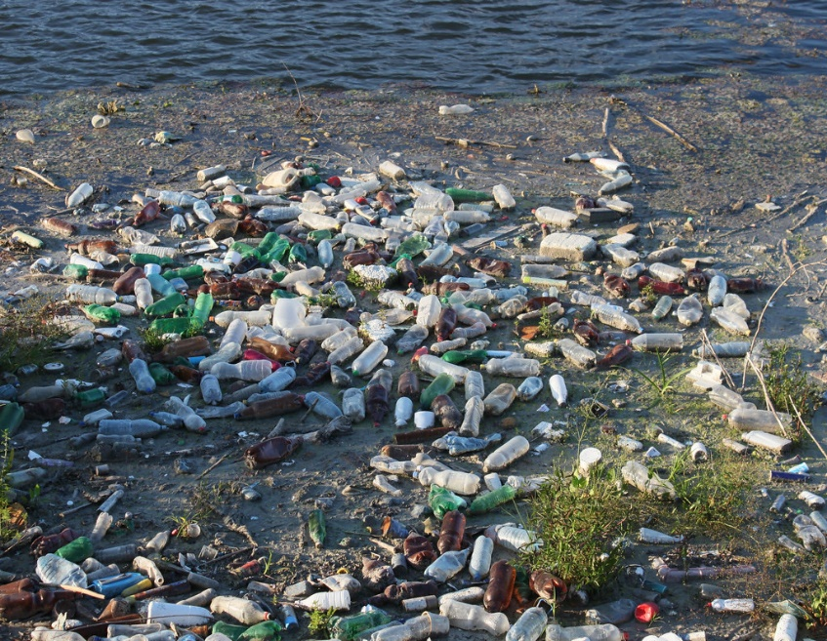
Cause of Water Pollution
Industry, agriculture and livestock farming.
Unexpected flood
Rubbish and faucal water
dumping.

Slide 8
Effect of Environment Pollution
Increased riIncreased risk of respiratory illness and cardiovascular problems.
sk of skin diseases.
May increase the risk of cancer.
Global warming.
Acid rain.
Ozone depletion.
Hazards to wildlife.
Water and Air Pollution create environment
Pollution. That is harmful for our environment.
For environment pollution many difficulties comes
Of our life. S-

Slide 9
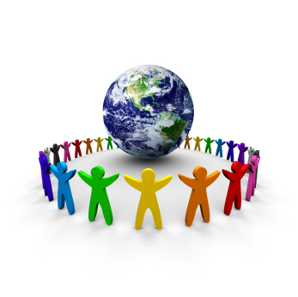
To Save our Environment
We must throw garbage in the right bins so that proper disposal of waste and waste management can be done. We need to make efforts in the right direction to conserve our natural resources and habitat. Some of the ways by which we can achieve this are to use renewable energy, avoid plastic bags, plant more trees etc.

Slide 10

The natural environment gives us a wealth of services that are difficult to measure in dollars. Natural areas help clean our air, purify our water, produce food and medicines, reduce chemical and noise pollution, slow floodwaters, and cool our streets. We call this work 'ecosystem services'.

Slide 11


